Slide 1

CSCE 693 – Software Evolution Lua : Language and Embedding
Air Force Institute of Technology
Douglas D. Hodson, PhD
Bldg 640, Room 307A
255-3636 x4719

Slide 2
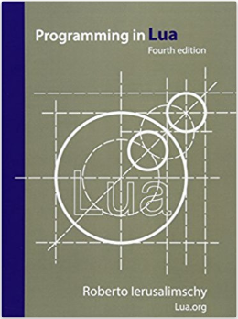
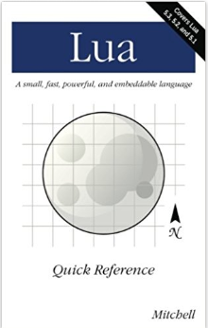
References
Official Reference
Quick; to the Point

Slide 3
References: Details
Lua 5.2 Bytecode and Virtual Machine, Dirk Laurie, 2013
Lua 5.3 Bytecode Reference, “A No-Frills Introduction to Lua 5.1 VM Instructions”
Lua 5.3 Reference Manual
A No-Frills Introduction to Lua 5.1 VM Instructions by Kein-Hong Man
Lua – An Extensible Extension Language, Roberto Ierusalimchy, Software Practice and Experience, Sept 1995
Programming with Multiple Paradigms in Lua, Roberto Ierusalimschy

Slide 4
Motivation

Slide 5
Why Embed A Scripting Language?
Host Code (C++)
Guest Code (Lua)
Host C++: Means to customize application
Initial ‘start up’ configuration
Enable ‘custom’ logic to be injected at select points
Host Lua: Means to provide REPL-based user interface (UI)
As opposed to graphical UI (GUI)
Interpreter provides a structured (i.e., language) to perform computations and access C/C++ defined functionalities
To use / learn how to use functionalities
To test functionalities

Slide 6
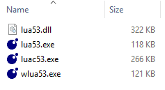
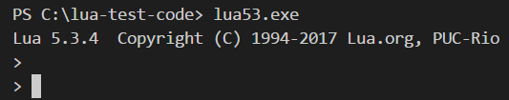
Files, Sizes, Etc.
REPL => Read, Evaluate, Print, Loop
REPL UI
Compiler
The only difference between wlua.exe and lua.exe is that the former has subsystem:windows rather than subsystem:console specified at link time. As a result, Windows will not associate wlua with a console, and does not create a console window.

Slide 7
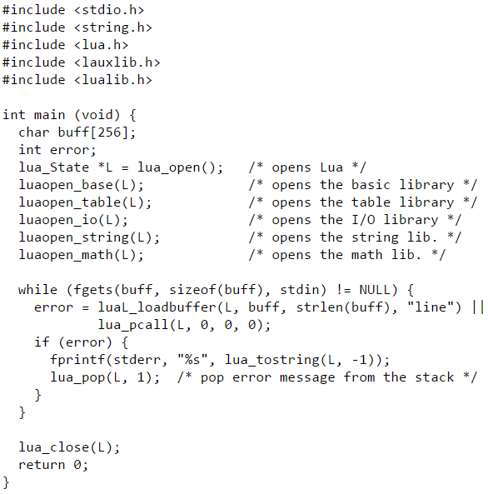
Example Lua REPL UI (100% C Code)

Slide 8
REPL UI (lua.exe)
The Lua command line interface
More sophisticated than example
It provide a better command line ‘editor’
Accepts arguments to alter behavior

Slide 9
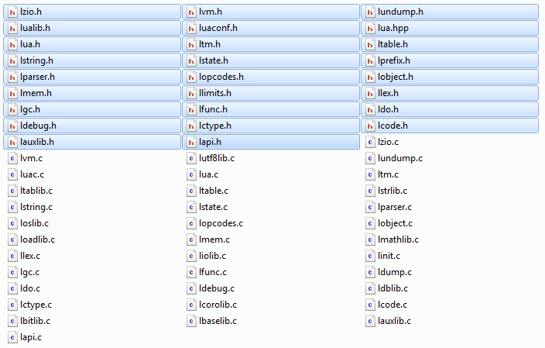
Lightweight C-based Source Code
Entire source tree

Slide 10
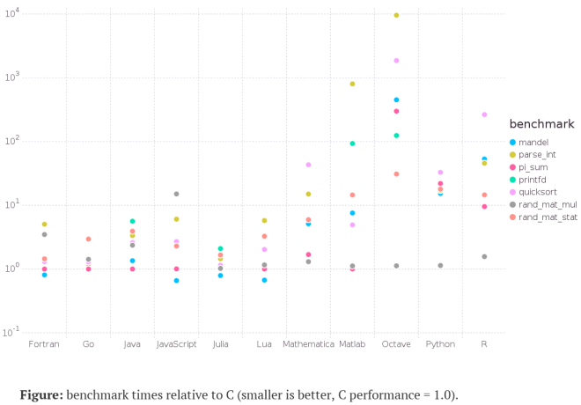
Performance
Reasonable good – in comparison with other scripting languages

Slide 11
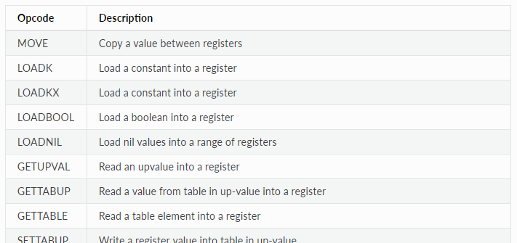
Internals / How it Works
BLUF: Well documented
Compiler creates bytecode; virtual machine executes it

Slide 12
Terminology
Host
The (typically C/C++) program that interacts with a Lua interpreter. The stand-alone Lua interpreter is an example of a C-based host
Block
A group of statements executed in sequential order. Blocks include function bodies and control structure bodies
C function
A special kind of function written in C that Lua can interact with

Slide 13
Terminology
List
A special kind of table that has non-nil values assigned to an unbroken sequence of integer keys from 1 to n, where n is the number of elements in the list. Lists may still have non-integer keys, but those keys and their associated values are ignored in list operations.
Upvalue
A non-local, non-global variable that a function has access to. In Lua upvalues are lexically scoped variables defined outside of functions, and in C they are values explicitly associated with C functions.
The stack
The C stack of Lua values associated with the applicable Lua interpreter, C function, or thread.

Slide 14
Language

Slide 15
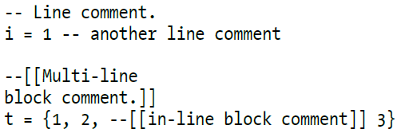
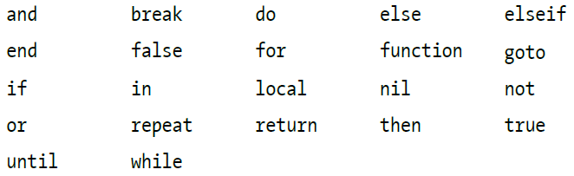
Comments / Reserved Words
Comments
Reserved words

Slide 16
Variables
Global and local variables
Globals do not need to be declared
Local’s declared using keyword local
Lexically scoped
Example: function bodies, control structure body parts, and Lua files

Slide 17
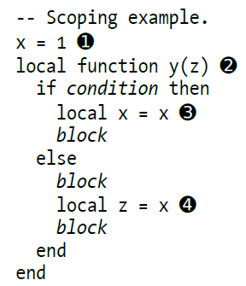
Variables
x is a global variable
y is a local function; z is an implicit local argument
x is a local variable being assigned to global x
z is a local variable being associated to global x

Slide 18
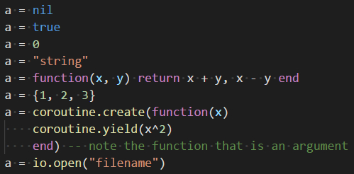
Types
Lua is dynamically typed – meaning, Lua variables have no defined type!

Slide 19
Types: Eight Basic Value Types
nil: single value (nil); corresponds to a null value in C
boolean: (true/false); equivalent to their C++ counterparts
number: (integers and floating point)
string: immutable, arbitrary sequences of bytes
function: consist of both Lua functions and C functions; first-class value; anonymous (they do not have names)
table: Lua’s primary data type; implemented as an associative array
thread: are separate, independent lines of execution; used to implement coroutines – collaborative threads (not asynchronous threads); they share the same global environment; Lua’s main thread is a coroutine
userdata: act in place of C data types that cannot be represented by any other Lua value; maps a Lua variable to data managed by the C code; Userdata values cannot be modified by Lua itself

Slide 20
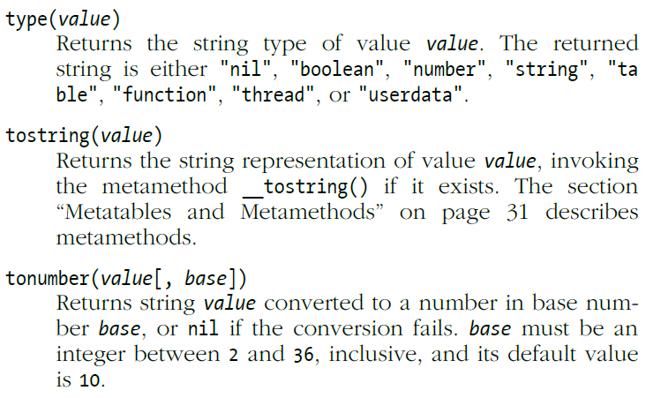
Basic Value Operations

Slide 21
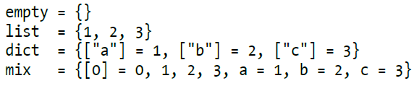
Lua table Type
Primary data type; hugely flexible
It is the only data structuring mechanism in Lua!
A table in Lua is essentially an associative array
Used to represent arrays, sets, records, and many other structures
Tables are used to represent packages and objects as well
Example: math.sin is a table with the sin function (although we mentally think of it as a library that contains the sin function)

Slide 22
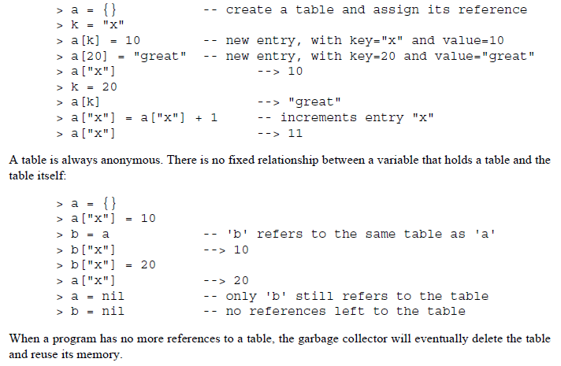
Constructor Expression {}

Slide 23
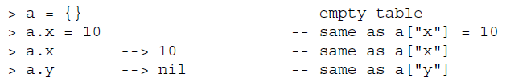
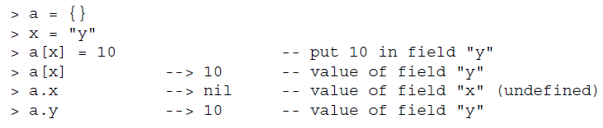
Structure Syntax (Intention)

Slide 24
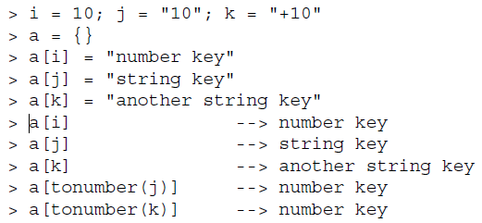
Indexing a table With Any Type
Number
String
String
Constructor
a[10]

Slide 25
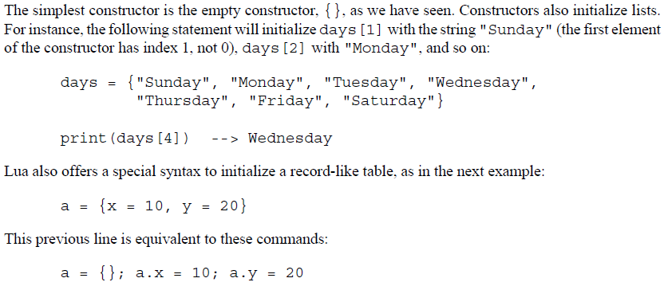

Table Constructors
List Style
Record Style

Slide 26
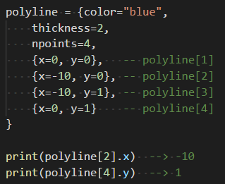
Table Constructors
Mixing record-like and list styles

Slide 27
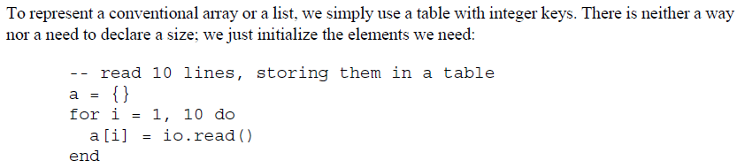
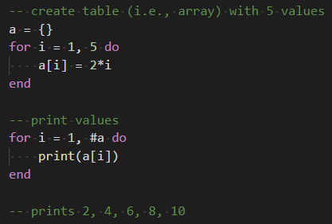
Arrays, Lists and Sequences
“#” is Length Operator

Slide 28
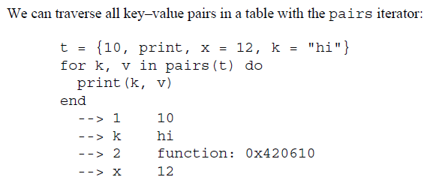
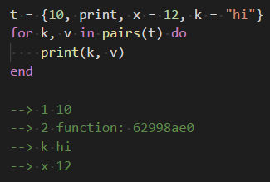
Table Traversal
The order in which elements are stored is undefined – it can change from run to run
This is a function; functions are first class objects (and stored in a table)

Slide 29
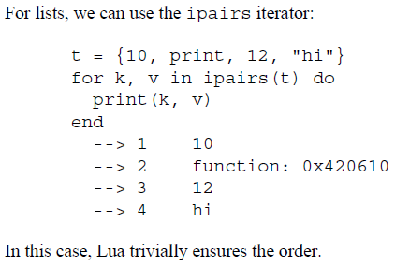
Table Traversal (Ensuring Order)

Slide 30
Modules

Slide 31

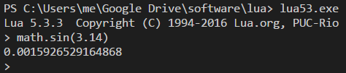
Fundamentals
File that is loaded and executed
The Lua stand-alone interpreter (REPL) preloads math and string modules
A module is some code (either in Lua or in C) that can be loaded through the function require which creates and returns a table!

Slide 32
Fundamentals
Using tables to implement modules means that modules are first-class values
First class means they can be stored in variables, passed as argument to functions, etc.
The function require
Is a regular function
Has a path that is searched to locate modules

Slide 33
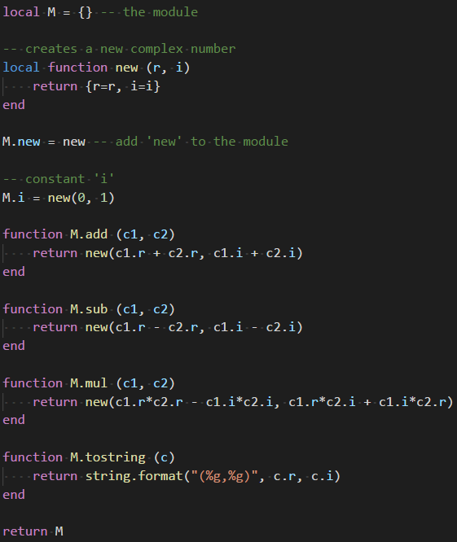
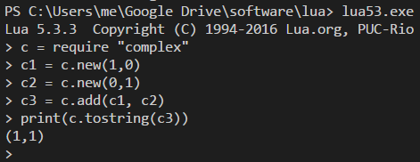

Slide 34
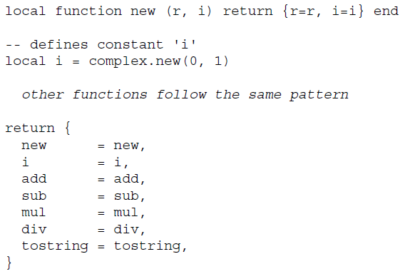
Module With Export List

Slide 35
Object-Oriented Programming
Lua supports object-oriented programming, though not in the traditional sense of supplying the means to create classes, methods, and objects
Instead, Lua can emulate an object-oriented system by using a blend of tables, metatables, and some special syntax

Slide 36
Objects
First-class functions + tables ≈ objects

Slide 37
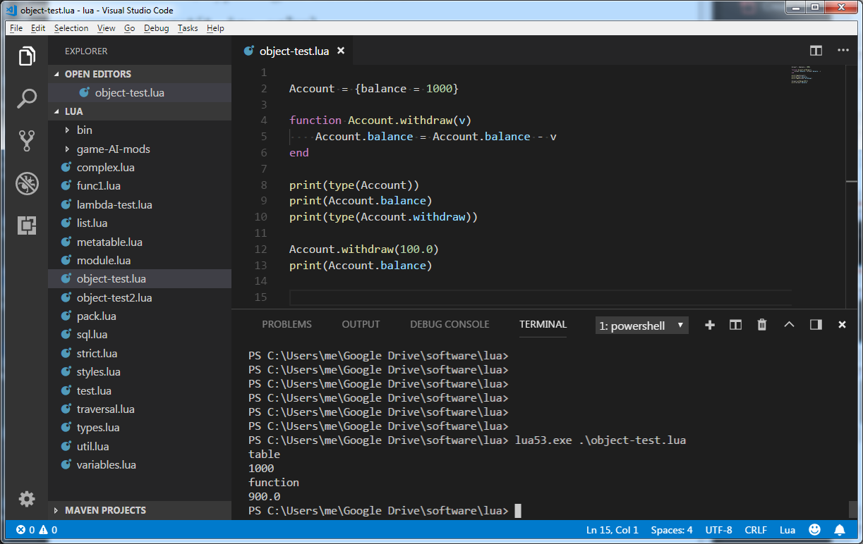
Object w/Global Data
This created a global variable “Account”
And hardwired it’s ‘methods’ to use that specific global name

Slide 38
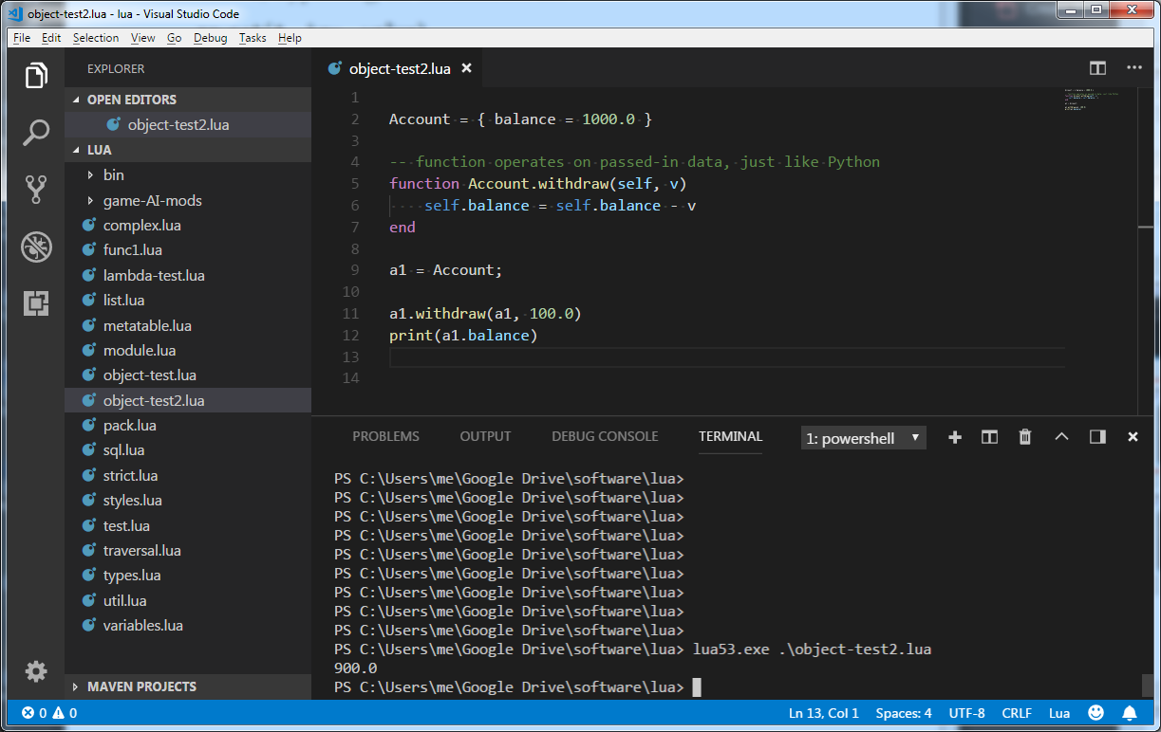
Object w/Python-like (self)

Slide 39
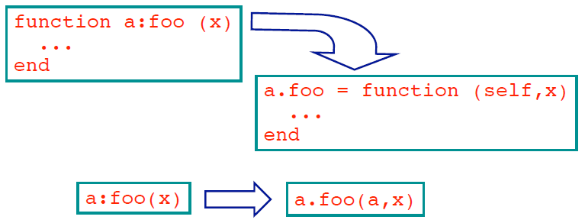
Objects
Syntactical sugar for methods
Handles self

Slide 40
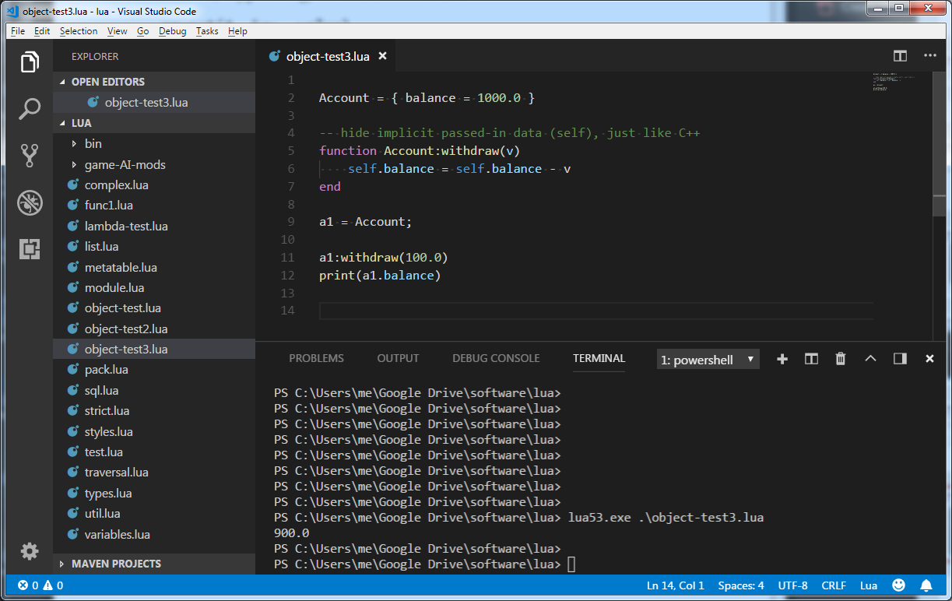
Objects w/Implicit ‘self’

Slide 41
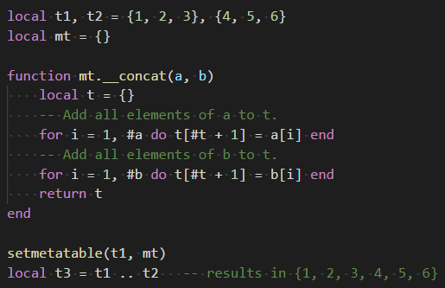
Metatable / Metamethods
A metatable is a special kind of table with specific keys assigned to user-defined functions called metamethods
When a value is assigned a metatable, operators using that value as an operand can behave differently

Slide 42
Embedding

Slide 43
Basic Lua Interpreter w/REPL

Slide 44
Addressing the Impedance Mismatch Between C/C++ and Lua
C++ Code
Lua Code

Slide 45
Impedance Mismatch
Concept of a stack
When C/C++ wants to call a Lua function, the function as well as its parameters are pushed onto the stack and then executed by the virtual machine
Return values are placed back on stack for C/C++ to retrieve
Same process happens in reverse when Lua code wants to call C/C++ code

Slide 46
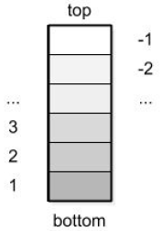
Stack
C/C++ Code
Lua Code

Slide 47
Stack
Keeps all Lua objects in use by a C function
Injection functions
Converts a C value into a Lua value
Push the result into the stack
Projection functions
Convert a Lua value into a C value
Get the Lua value from anywhere in the stack

Slide 48
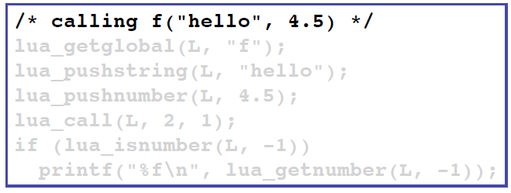
Stack
Example: calling the Lua function “f” from C

Slide 49
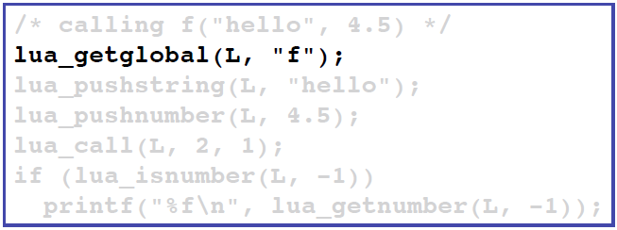
Stack
Example: calling a Lua function from C
L is Lua State
Pushes onto the stack the value of the global name (i.e., “f”)

Slide 50
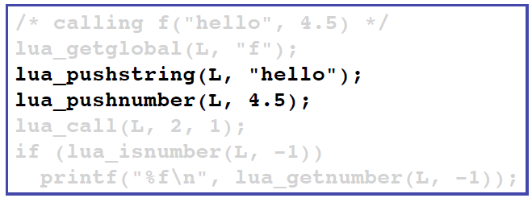
Stack
Example: calling a Lua function from C
push arguments (i.e., “hello” and 4.5)

Slide 51
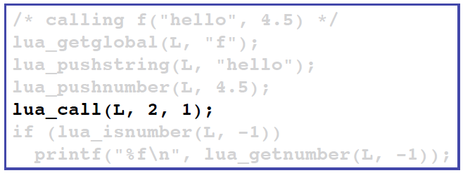
Stack
Example: calling a Lua function from C
Calls a function (i.e., “f”)
lua_call(lua_State*, # of args, # of results)

Slide 52
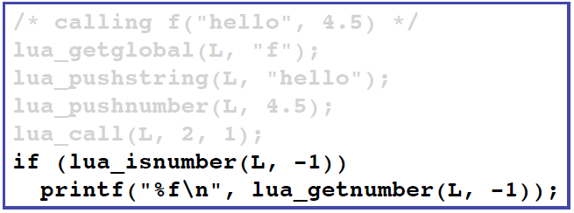
Stack
Example: calling a Lua function from C
Get result back from stack

Slide 53
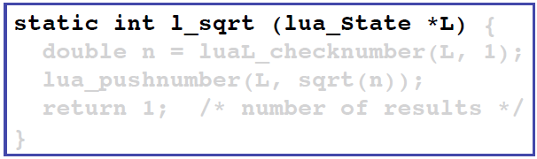
Stack
Example: calling a C function from Lua
Define a “special” C function that can accept a Lua state
The passed lua state will be used to obtain arguments and provide results

Slide 54
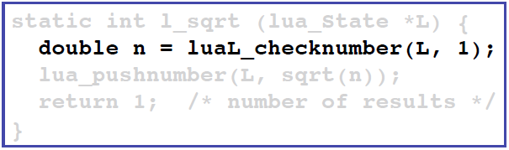
Stack
Example: calling a C function from Lua
Get arguments from the stack

Slide 55
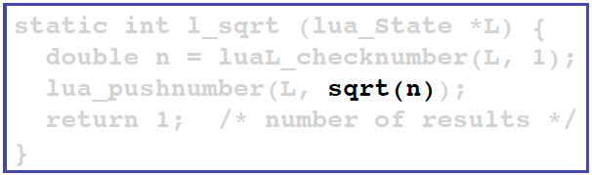
Stack
Example: calling a C function from Lua
Execute “C” function

Slide 56
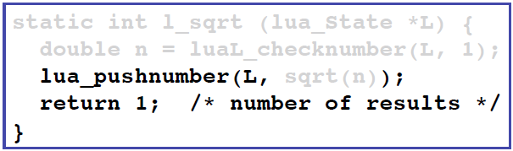
Stack
Example: calling a C function from Lua
Push return value(s) back onto stack

Slide 57
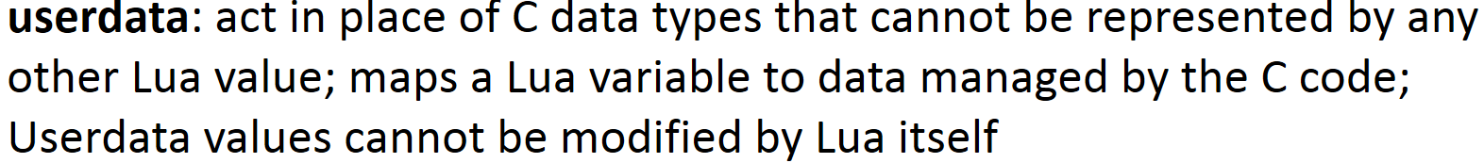
Issues to Consider
How do I create an object instance
From lua: call code to create instance – it should return userdata
Conceptually simple, but…..
Who controls memory? (C code or Lua garbage collector?)
Use cases
C/C++ creates a block of data (userdata) and ‘passes’ it back to Lua
C/C++ returns a pointer in a block of data (userdata) that it is still using
Lots of “boilerplate” code being used to marshal arguments back and forth – Can we simplify or automate?

Slide 58
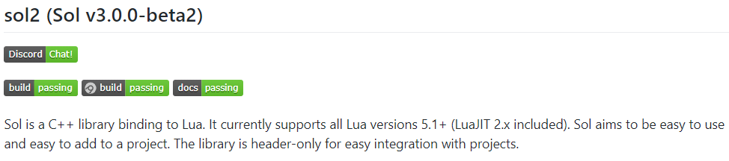
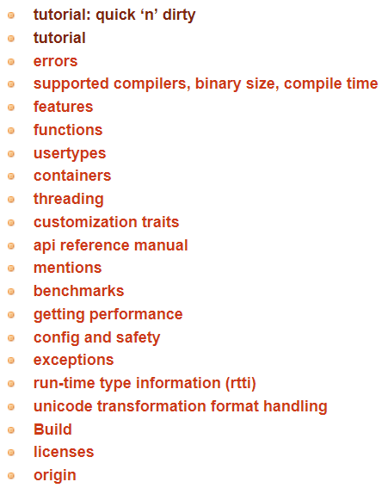
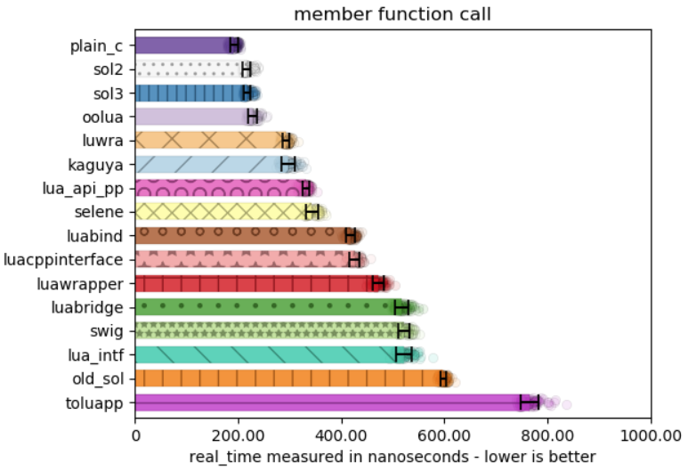
Automation Using Templates

Slide 59
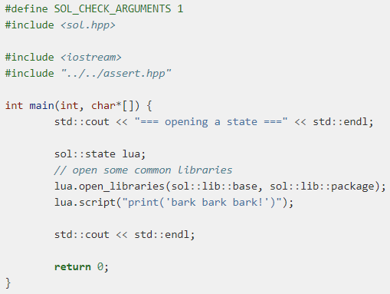
sol2 / sol3 Example

Slide 60
EOF

